Slide 1

Artificial Intelligence in Alzheimer's Disease Diagnosis
From Neuroimaging Pipelines to Deep Learning Classification
Paris Karageorgakis
University of Piraeus, Department of Informatics
Thesis Advisor: Prof. Christos Douligeris

Slide 2
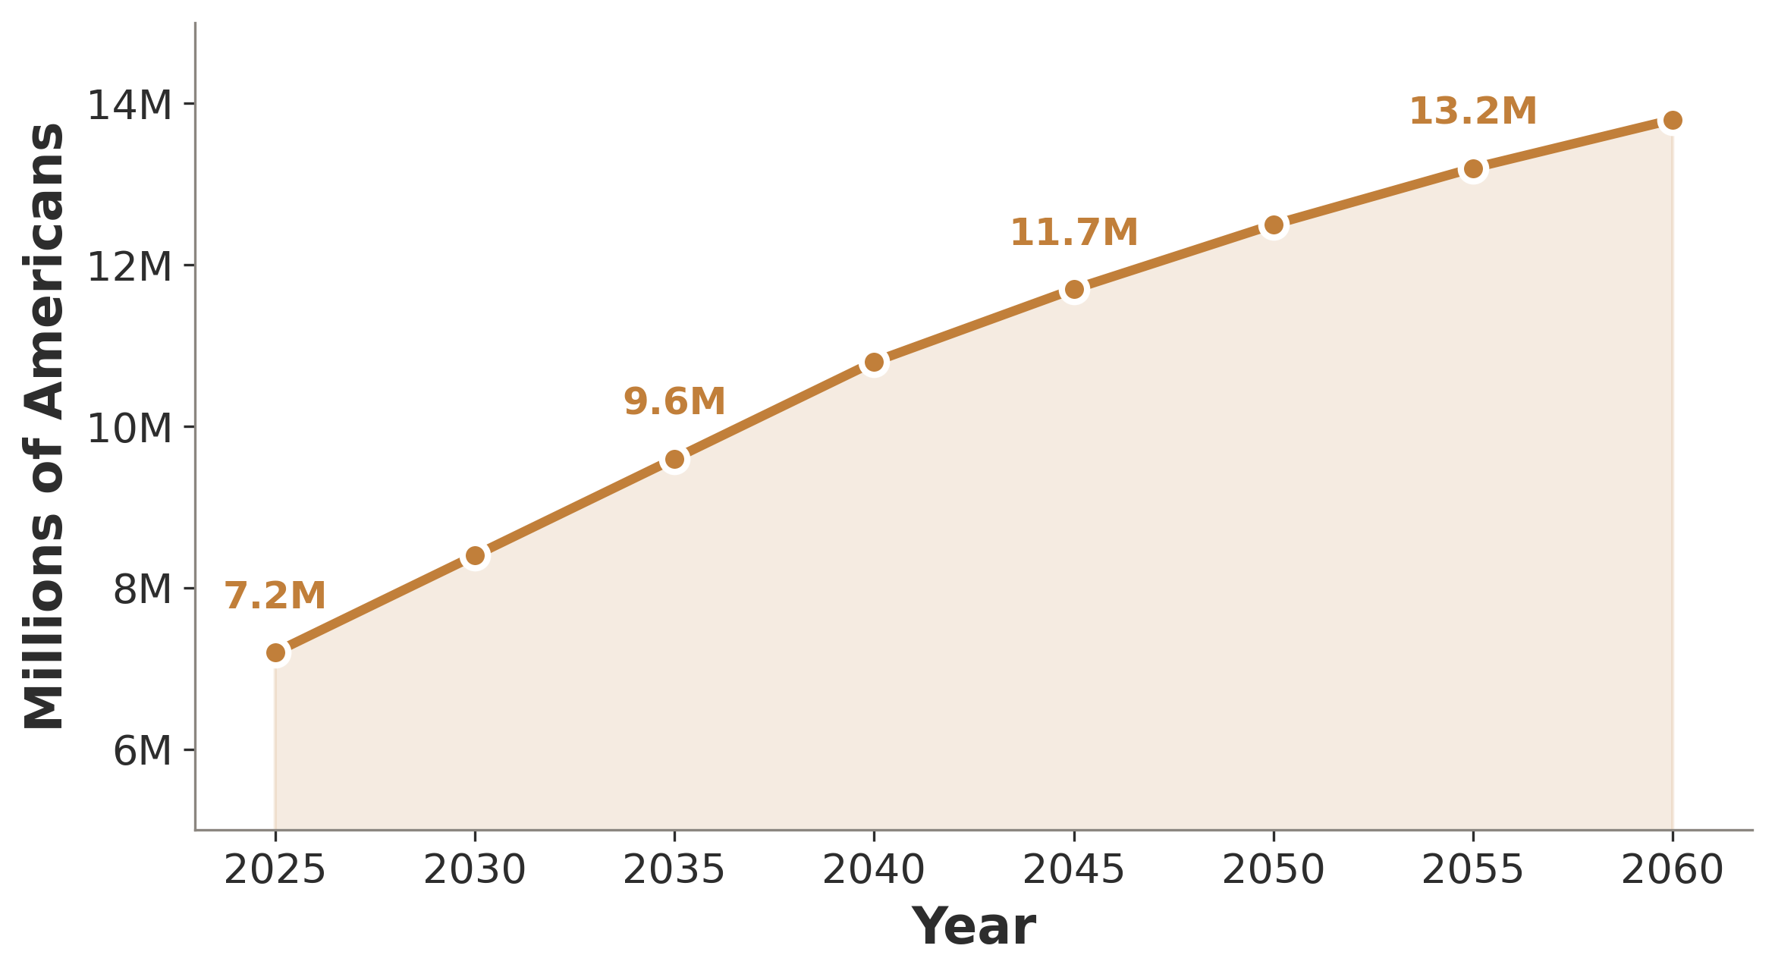
THE PROBLEM
7.2 Million
Americans living with Alzheimer's disease
• Every 65 seconds, someone develops AD
• $360 billion annual healthcare cost
• 6th leading cause of death in the US
• Projected to reach 13.8M by 2060
Alzheimer's Association, 2024 Facts and Figures | Rajan et al., 2021

Slide 3
THE 20-YEAR WINDOW
AT(N) FRAMEWORK
Pathological changes begin 15–20 years before the first clinical symptoms.
Biological Classification of AD
A
Amyloid
Aβ plaques accumulate 15–20 years before symptoms
By the time of diagnosis, neuronal loss is already irreversible.
The diagnostic challenge:
• MCI patients convert to AD at 10–15% per year
• Clinical diagnosis accuracy: ~77% (confirmed at autopsy)
• Early intervention could slow progression by 30%
T
Tau
Neurofibrillary tangles spread along predictable pathways
(N)
Neurodegeneration
Synaptic loss, brain atrophy measurable on MRI
Jack et al., 2018 | Sperling et al., 2011 | NIA-AA Research Framework

Slide 4
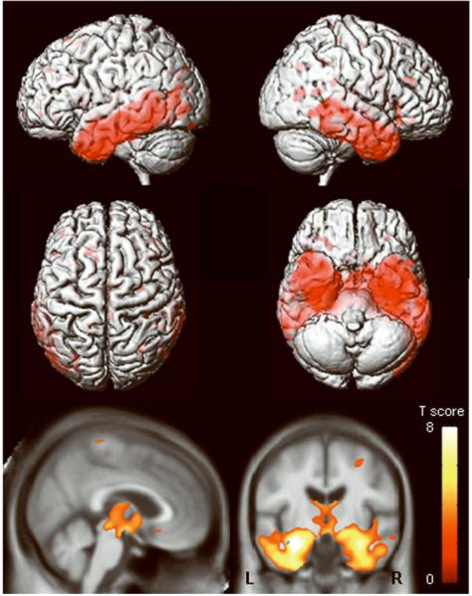
WHY NEUROIMAGING
The Window into Brain Pathology
Non-invasive
No surgery, no lumbar puncture required
Quantifiable
Volumetric measurements enable objective tracking
Reproducible
Standardized protocols across clinical sites
Accessible
MRI available in most medical centers worldwide
Jack et al., 2010 | Defined in MRI context by Defined in MRI context

Slide 5
BENCHMARK DATASETS
The Three Pillars of AD Neuroimaging Research
ADNI
AIBL
OASIS
Alzheimer's Disease Neuroimaging Initiative
Australian Imaging, Biomarkers & Lifestyle
Open Access Series of Imaging Studies
• 2,400+ subjects
• 1,100+ subjects
• 2,000+ subjects
• Longitudinal since 2004
• Melbourne & Perth cohorts
• Cross-sectional + longitudinal
• MRI + PET + CSF + genetics
• Focus on lifestyle factors
• Freely available
• Gold standard for method validation
• Diverse population sampling
• Ages 18–96 years
Mueller et al., 2005 (ADNI) | Ellis et al., 2009 (AIBL) | Marcus et al., 2007 (OASIS)

Slide 6
ACT II
Seeing the Brain
From MRI physics to preprocessing pipelines to machine learning

Slide 7
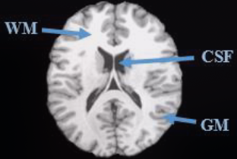
IMAGING FUNDAMENTALS
MRI: The Structural Gold Standard
• Nuclear magnetic resonance of hydrogen atoms
• T1-weighted: Gray matter dark, white matter bright
• T2-weighted: CSF bright, sensitive to edema
• Sub-millimeter resolution (0.5–1 mm voxels)
• Larmor equation: ω = γB₀ governs precession frequency
• No ionizing radiation — safe for longitudinal studies
Bitar et al., 2006 | Symms et al., 2004 | McRobbie et al., 2017

Slide 8
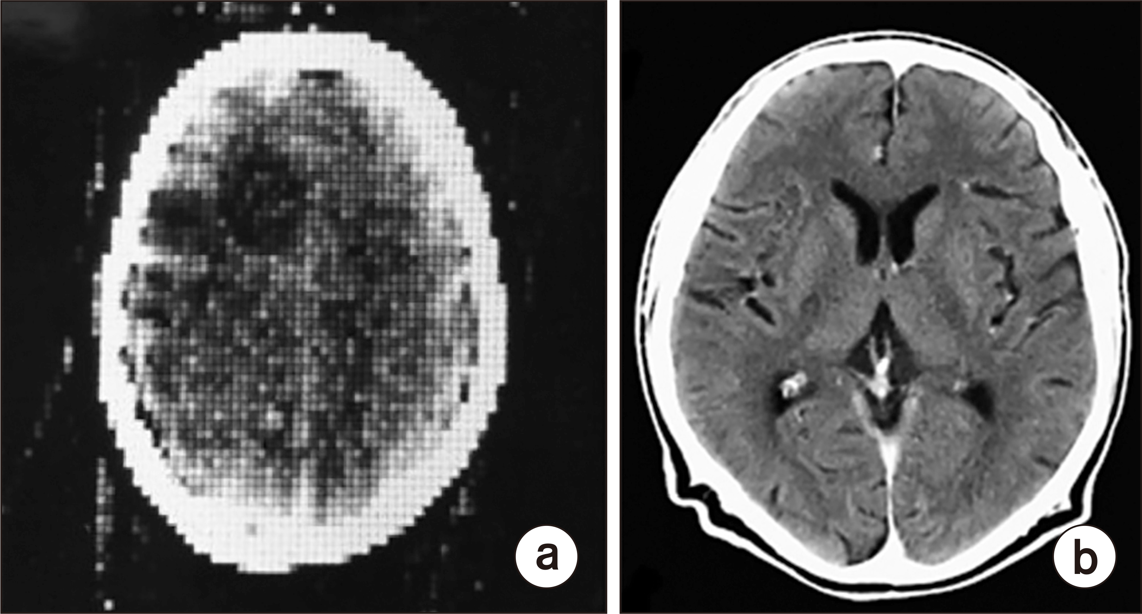
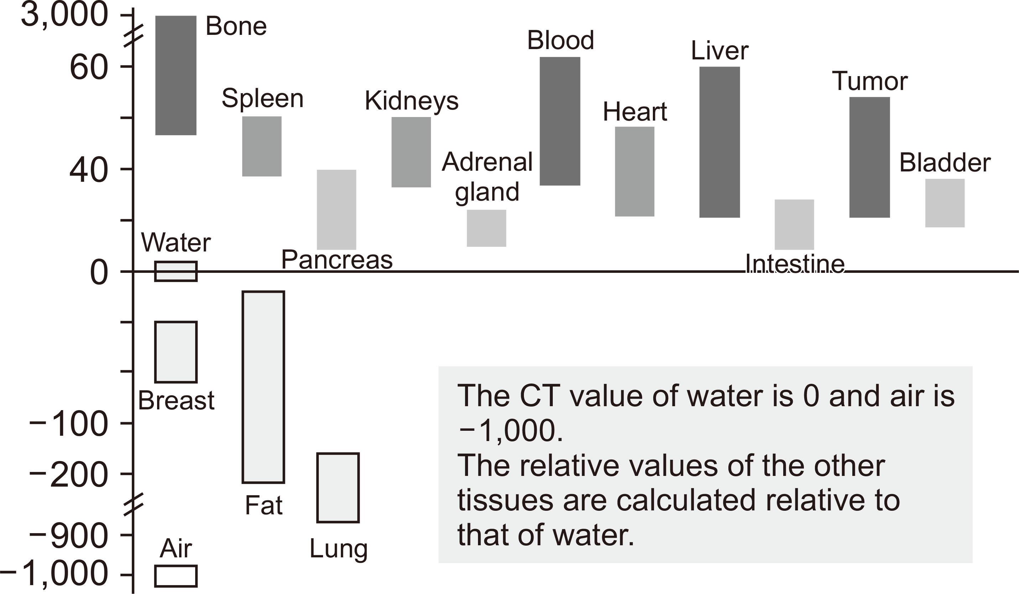
IMAGING MODALITIES BEYOND MRI
CT & PET: Complementary Windows
Computed Tomography
PET Biomarkers
• X-ray attenuation imaging
• FDG-PET: 90% sensitivity for AD
• Fast acquisition (~seconds)
• Amyloid PET: Detects Aβ plaques in vivo
• Detects gross atrophy & calcifications
• Tau PET: Maps tangle distribution
• Limited soft-tissue contrast vs MRI
• Quantifies molecular pathology directly
Marcus et al., 2014 | Johnson et al., 2012 | Minoshima et al., 1997 | Clark et al., 2011

Slide 9
THE PREPROCESSING PIPELINE
5 Steps from Raw Scan to Analysis-Ready Data
01
02
03
04
05
Registration
Skull Stripping
Intensity Normalization
Denoising
Segmentation
→
→
→
→
Align to standard space (MNI152 template)
Remove non-brain tissue (BET, HD-BET, SynthStrip)
Standardize signal (Z-Score, White Stripe)
Remove acquisition noise (NLM, BM3D, Deep Learning)
Classify tissue types (GM, WM, CSF)
Ashburner, 2012 | Smith, 2002 | Manjón & Coupé, 2016

Slide 10
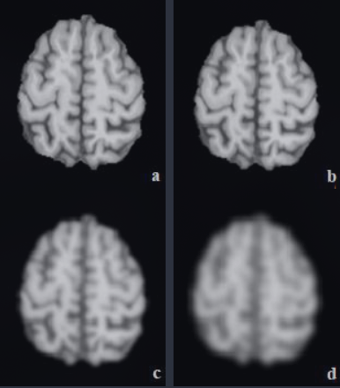
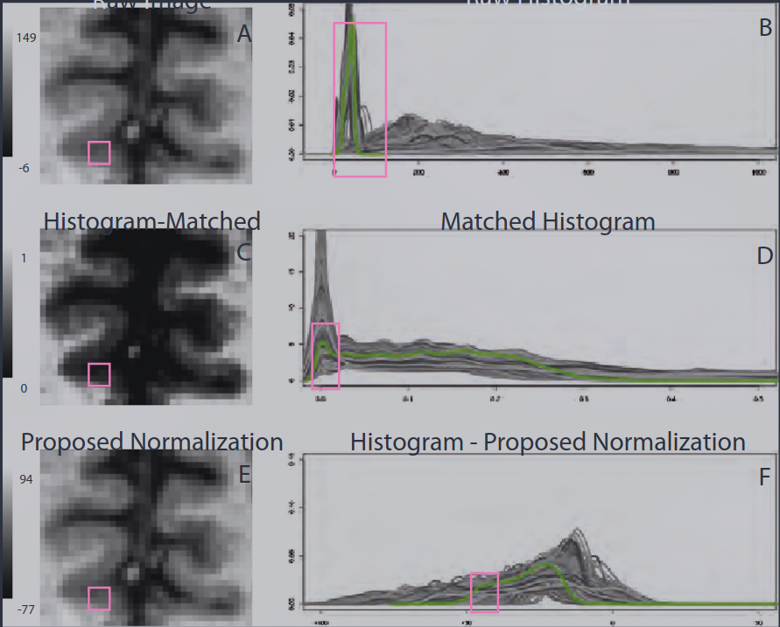
SIGNAL CLEANING
Intensity Normalization & Denoising
Intensity Normalization
Denoising
• Z-Score: Mean-center, unit-variance per subject
• NLM: Non-Local Means (patch-based similarity)
• White Stripe: Normalize to normal-appearing white matter
• BM3D: Block-Matching 3D (transform-domain filtering)
• Essential for cross-site comparisons
• Deep Learning: CNN-based denoising autoencoders
Shinohara et al., 2014 | Buades et al., 2005 | Dabov et al., 2007

Slide 11
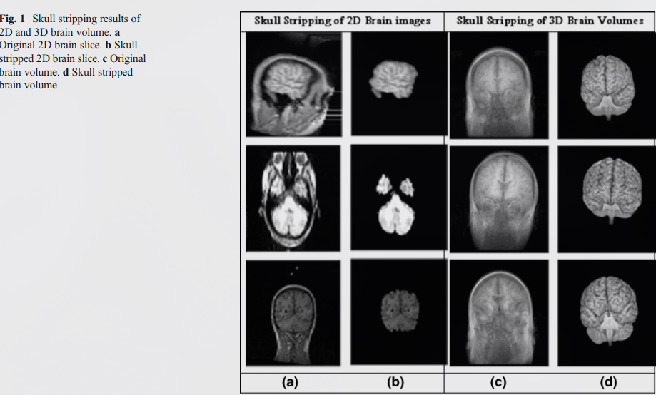
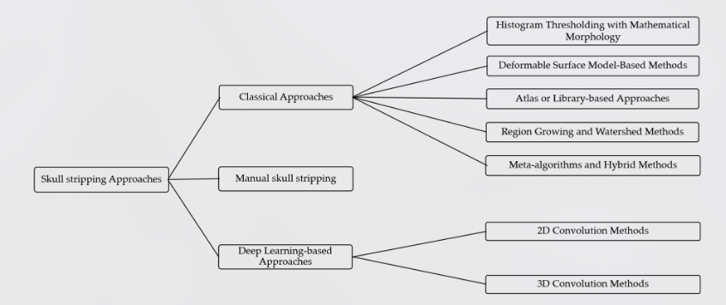
SKULL STRIPPING
Removing Non-Brain Tissue
BET
Brain Extraction Tool — surface deformation model
HD-BET
Deep learning — robust across scanners, 95%+ Dice
SynthStrip
Synthesis-based — contrast-agnostic extraction
⚠ Shortcut Learning Risk
Models can exploit skull artifacts as class features rather than learning true brain pathology patterns.
Smith, 2002 | Isensee et al., 2019 | Hoopes et al., 2022

Slide 12
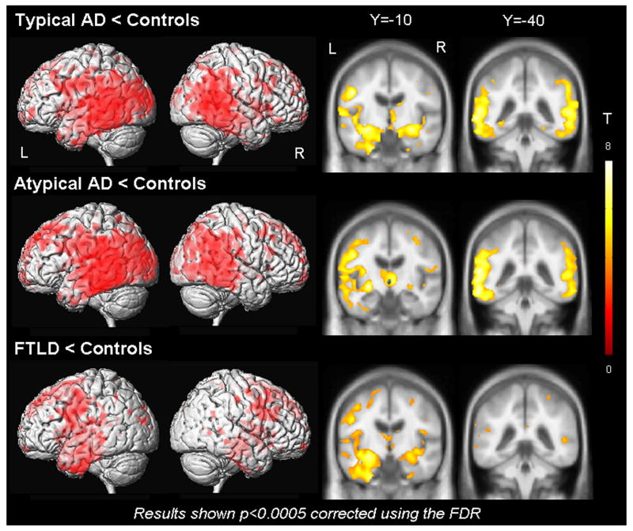
VOXEL-BASED MORPHOMETRY
Whole-Brain Analysis of Structural Changes
• Voxel-by-voxel statistical comparison of gray matter density
• Hippocampal atrophy: hallmark signature of early AD
• AUC > 0.90 for AD vs healthy controls
• Reveals distributed patterns invisible to visual inspection
• Can track atrophy progression over time
Ashburner & Friston, 2000 | Karas et al., 2004 | Whitwell, 2009

Slide 13
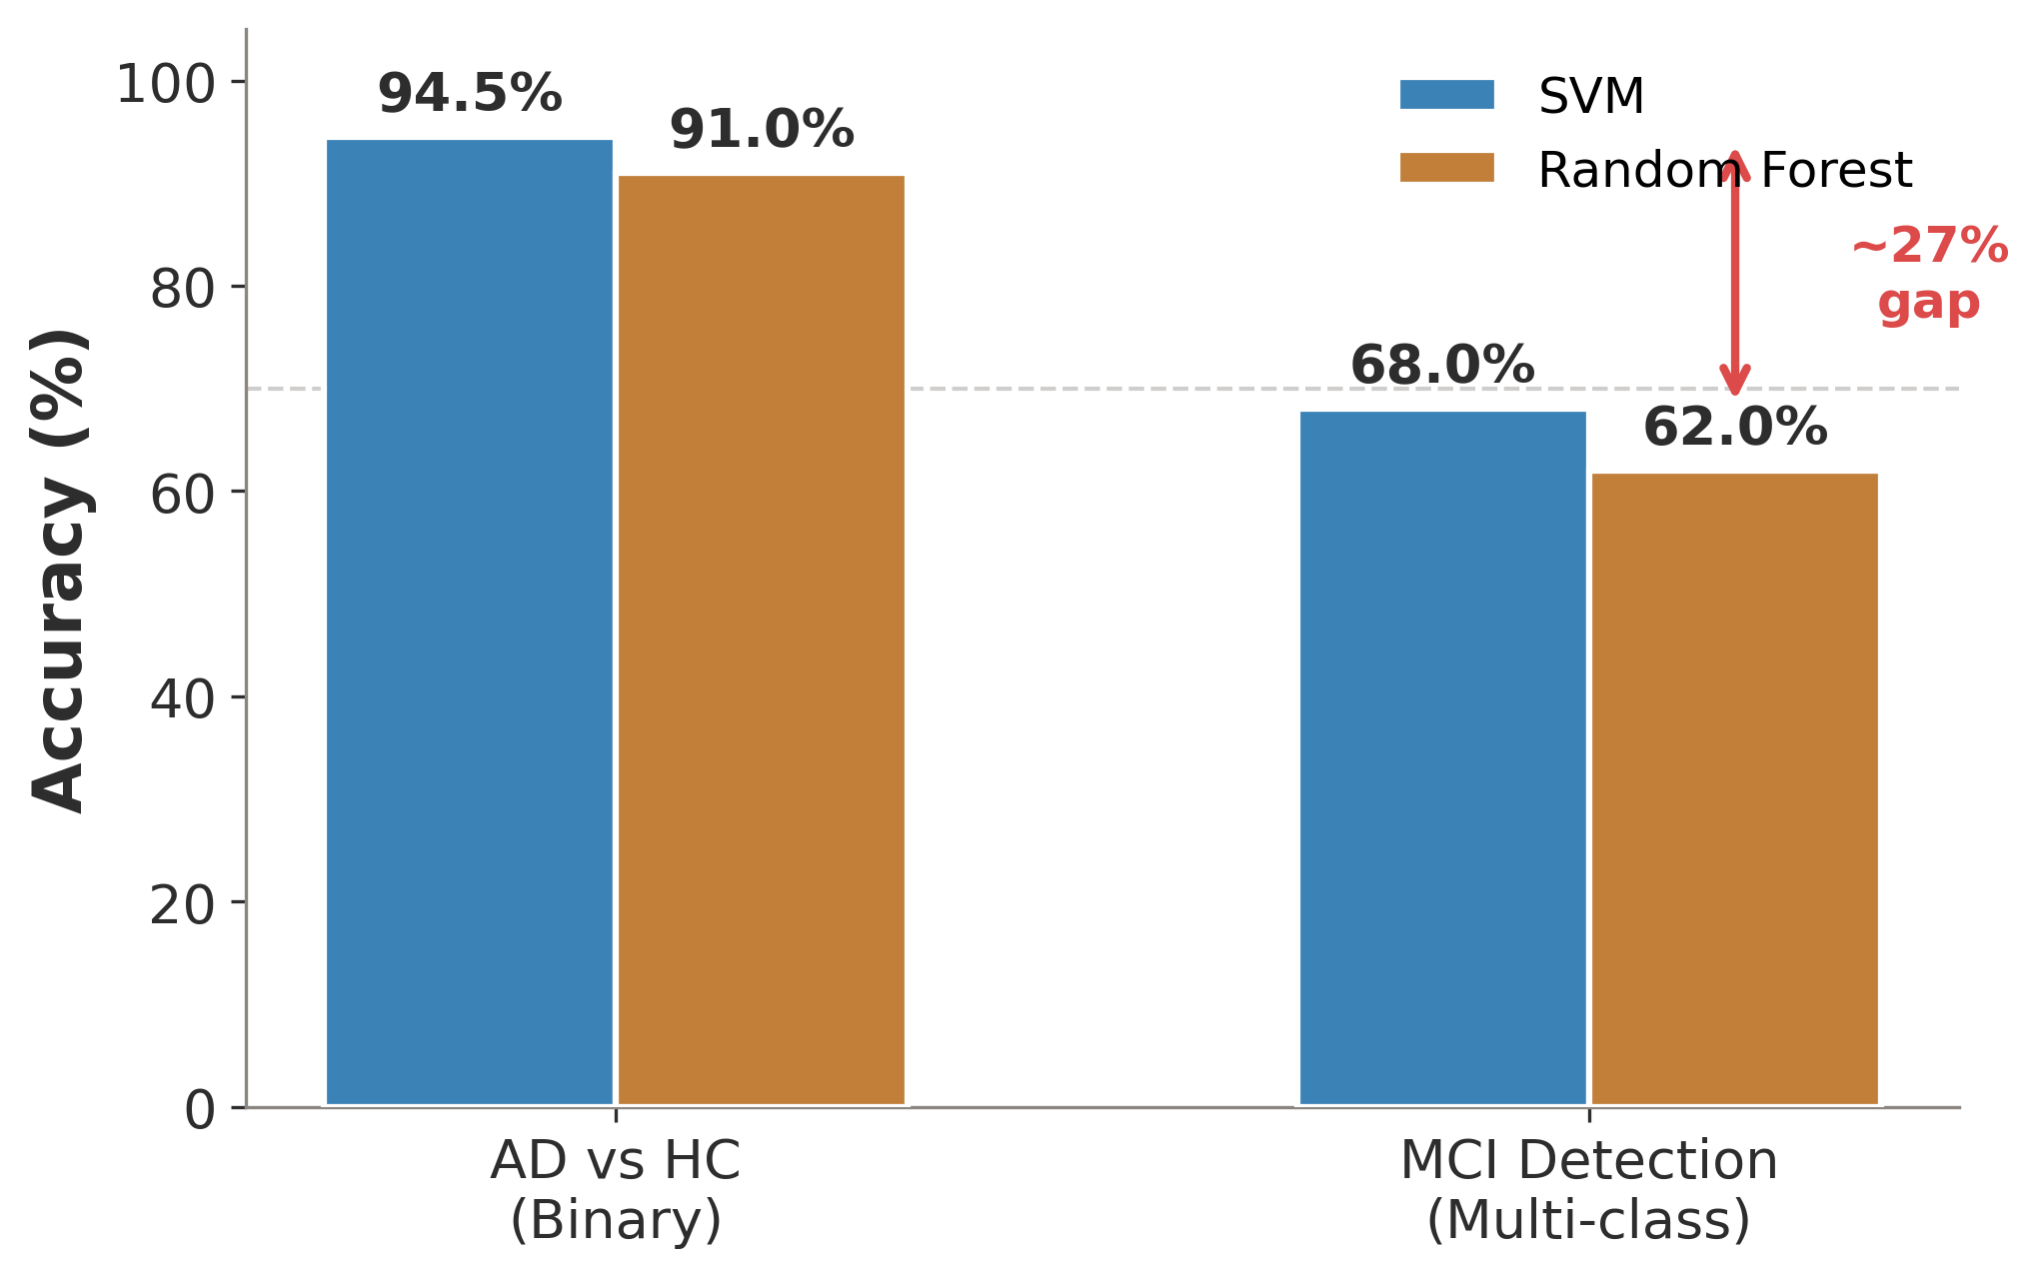
CLASSICAL MACHINE LEARNING
94.5%
SVM accuracy for AD vs. healthy controls
But MCI detection plummets to ~68%
• SVM, Random Forest, Logistic Regression dominate pre-2016
• Handcrafted features: volume, cortical thickness, texture
• Binary AD/HC: near-clinical performance
• Multi-class with MCI: dramatic accuracy drop
• Feature engineering = manual, limited, domain-dependent
Klöppel et al., 2008 | Cuingnet et al., 2011 | Salvatore et al., 2015

Slide 14
DEEP LEARNING ARCHITECTURES
From CNNs to Transformers
Convolutional Neural Networks
Vision Transformers
2D CNNs: Single-slice processing (ResNet-18, VGG-16)
ViT: Patches as tokens, global attention, data-hungry
3D CNNs: Volumetric convolutions capture spatial context
Swin Transformer: Shifted windows — local + global attention, efficient
DenseNet: Dense connections, feature reuse, fewer parameters
DeiT: Data-efficient training with knowledge distillation
ResNet: Skip connections enable very deep networks (152+ layers)
Hybrid ViT+CNN: CNN backbone + transformer head for small datasets
Hybrid CNN+SVM: CNN features fed to SVM classifier — 82–90% on AD
Key advantage: Pre-training on ImageNet transfers to medical imaging
Key Insight: Transformers achieve state-of-the-art performance on medical imaging benchmarks, but require careful handling of small datasets and class imbalance — motivating our experimental validation in the next section.
Dosovitskiy et al., 2021 | Liu et al., 2021 | He et al., 2016 | Huang et al., 2017

Slide 15
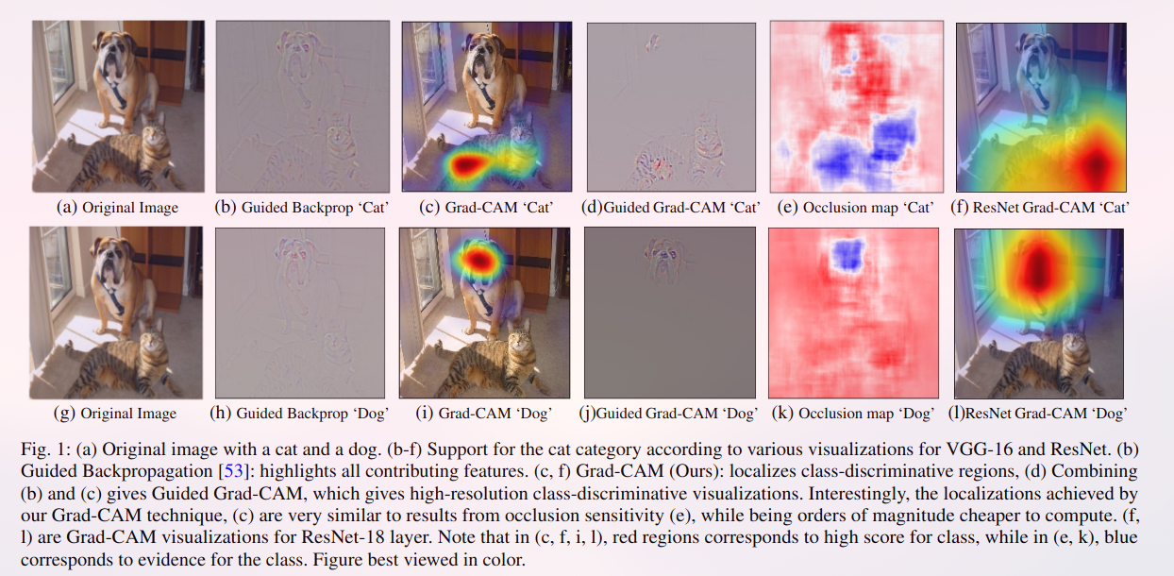
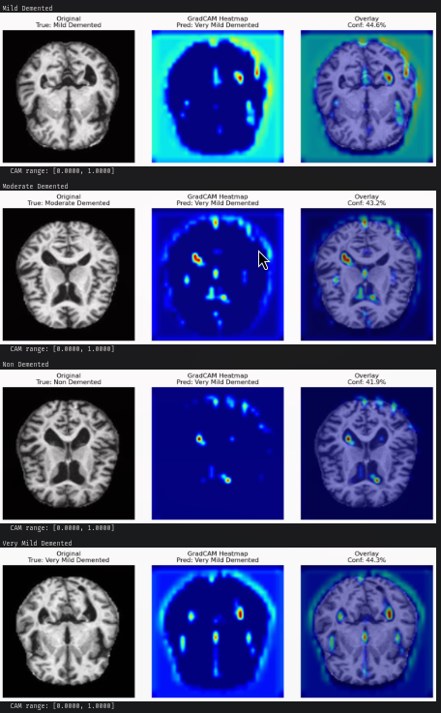
EXPLAINABILITY (XAI)
Opening the Black Box
Transparency: How does the model make decisions?
Interpretability: Can clinicians understand the reasoning?
Trustworthiness: Are predictions reliable for clinical use?
• Grad-CAM: Gradient-weighted class activation maps
• LIME: Local interpretable model-agnostic explanations
• SHAP: SHapley Additive exPlanations (game-theoretic)
Selvaraju et al., 2017 | Ribeiro et al., 2016 | Lundberg & Lee, 2017

Slide 16
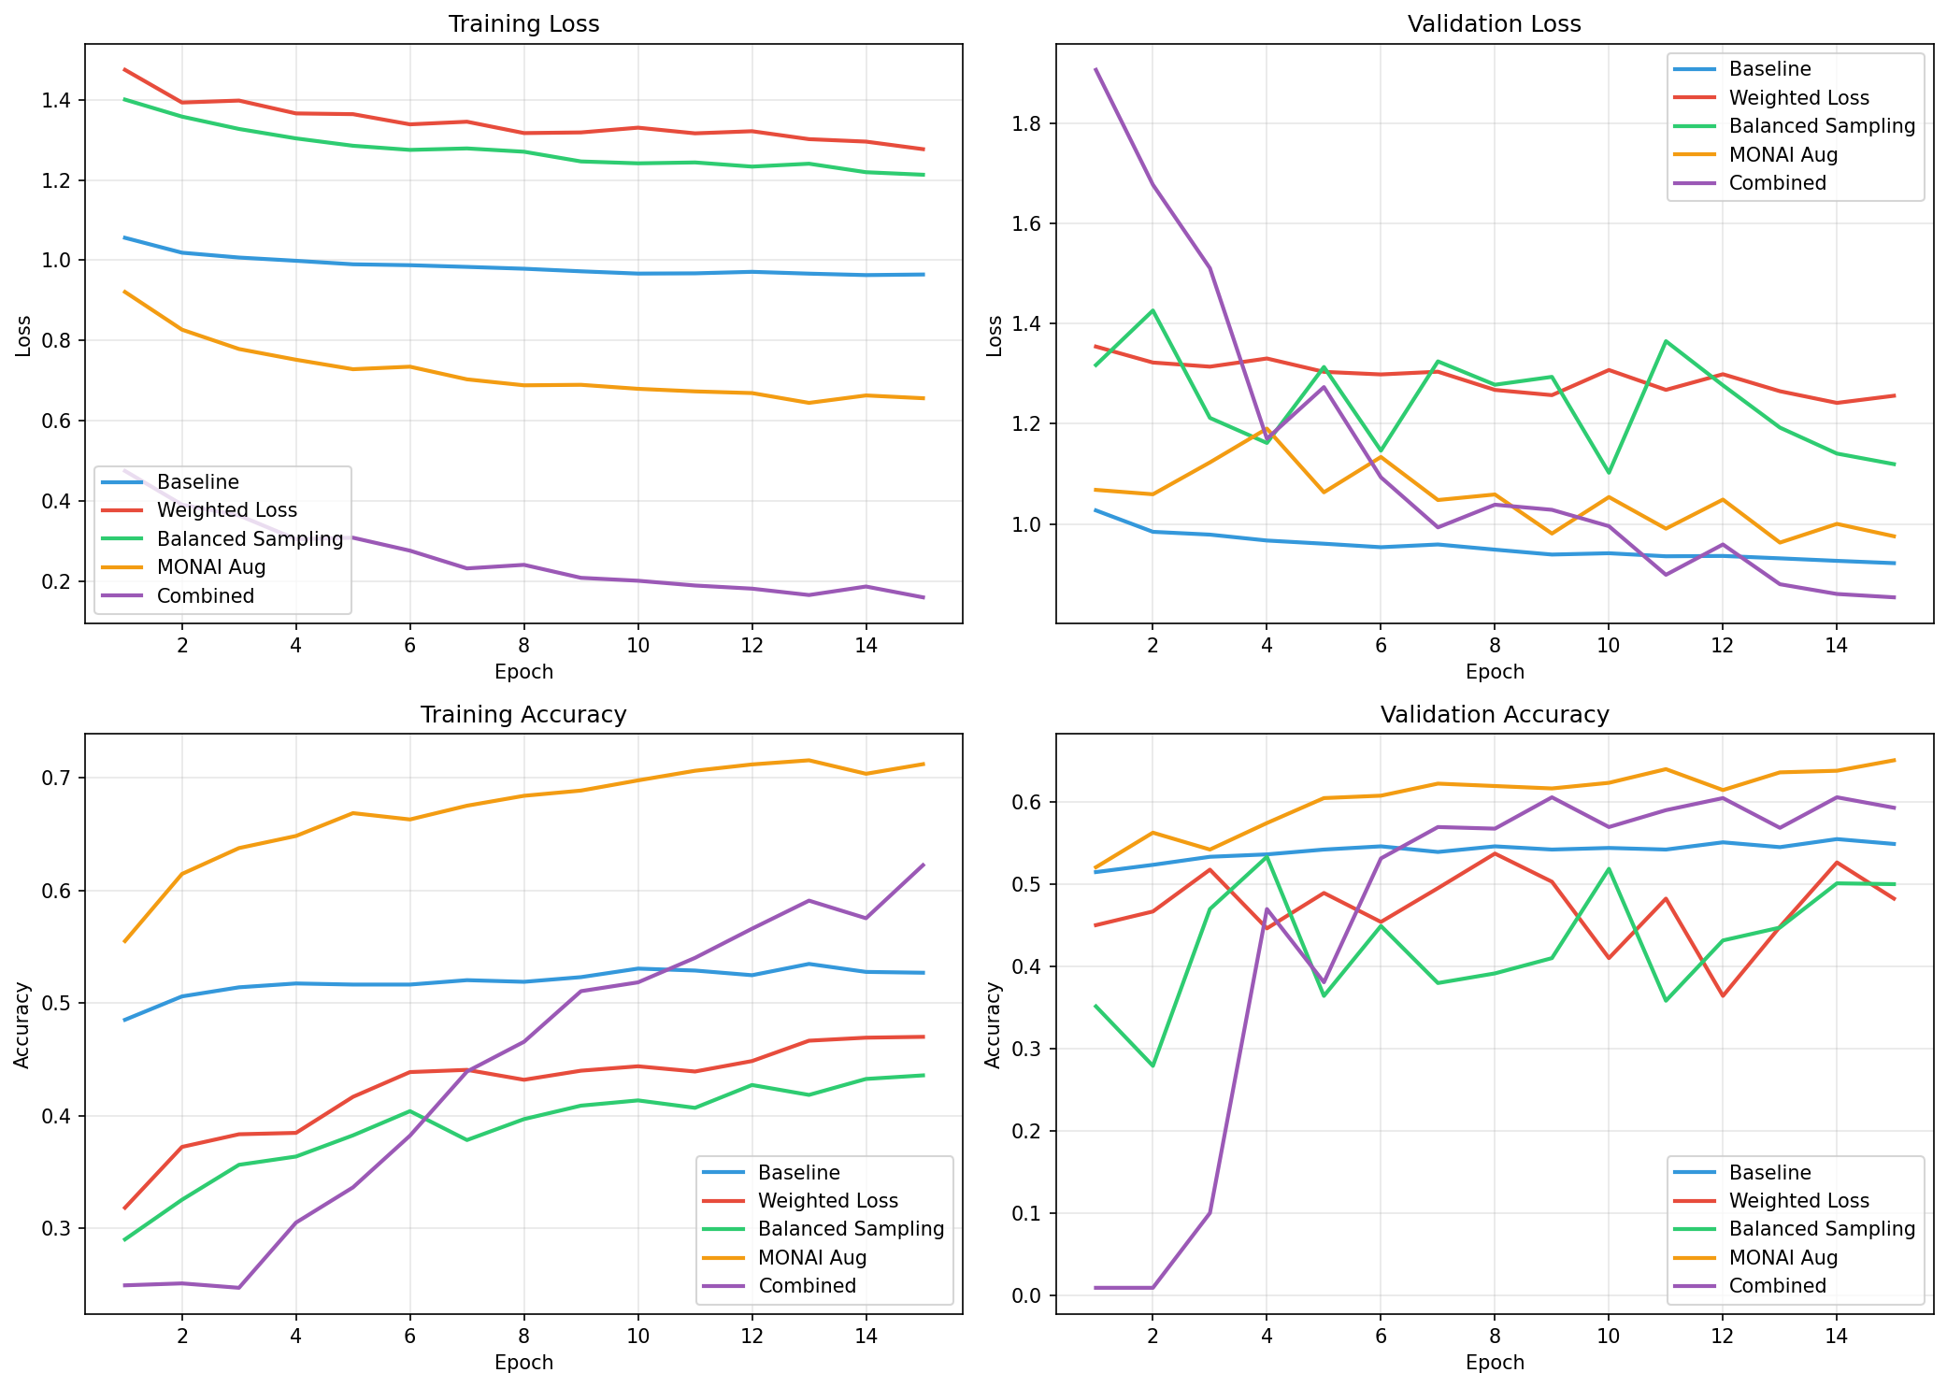
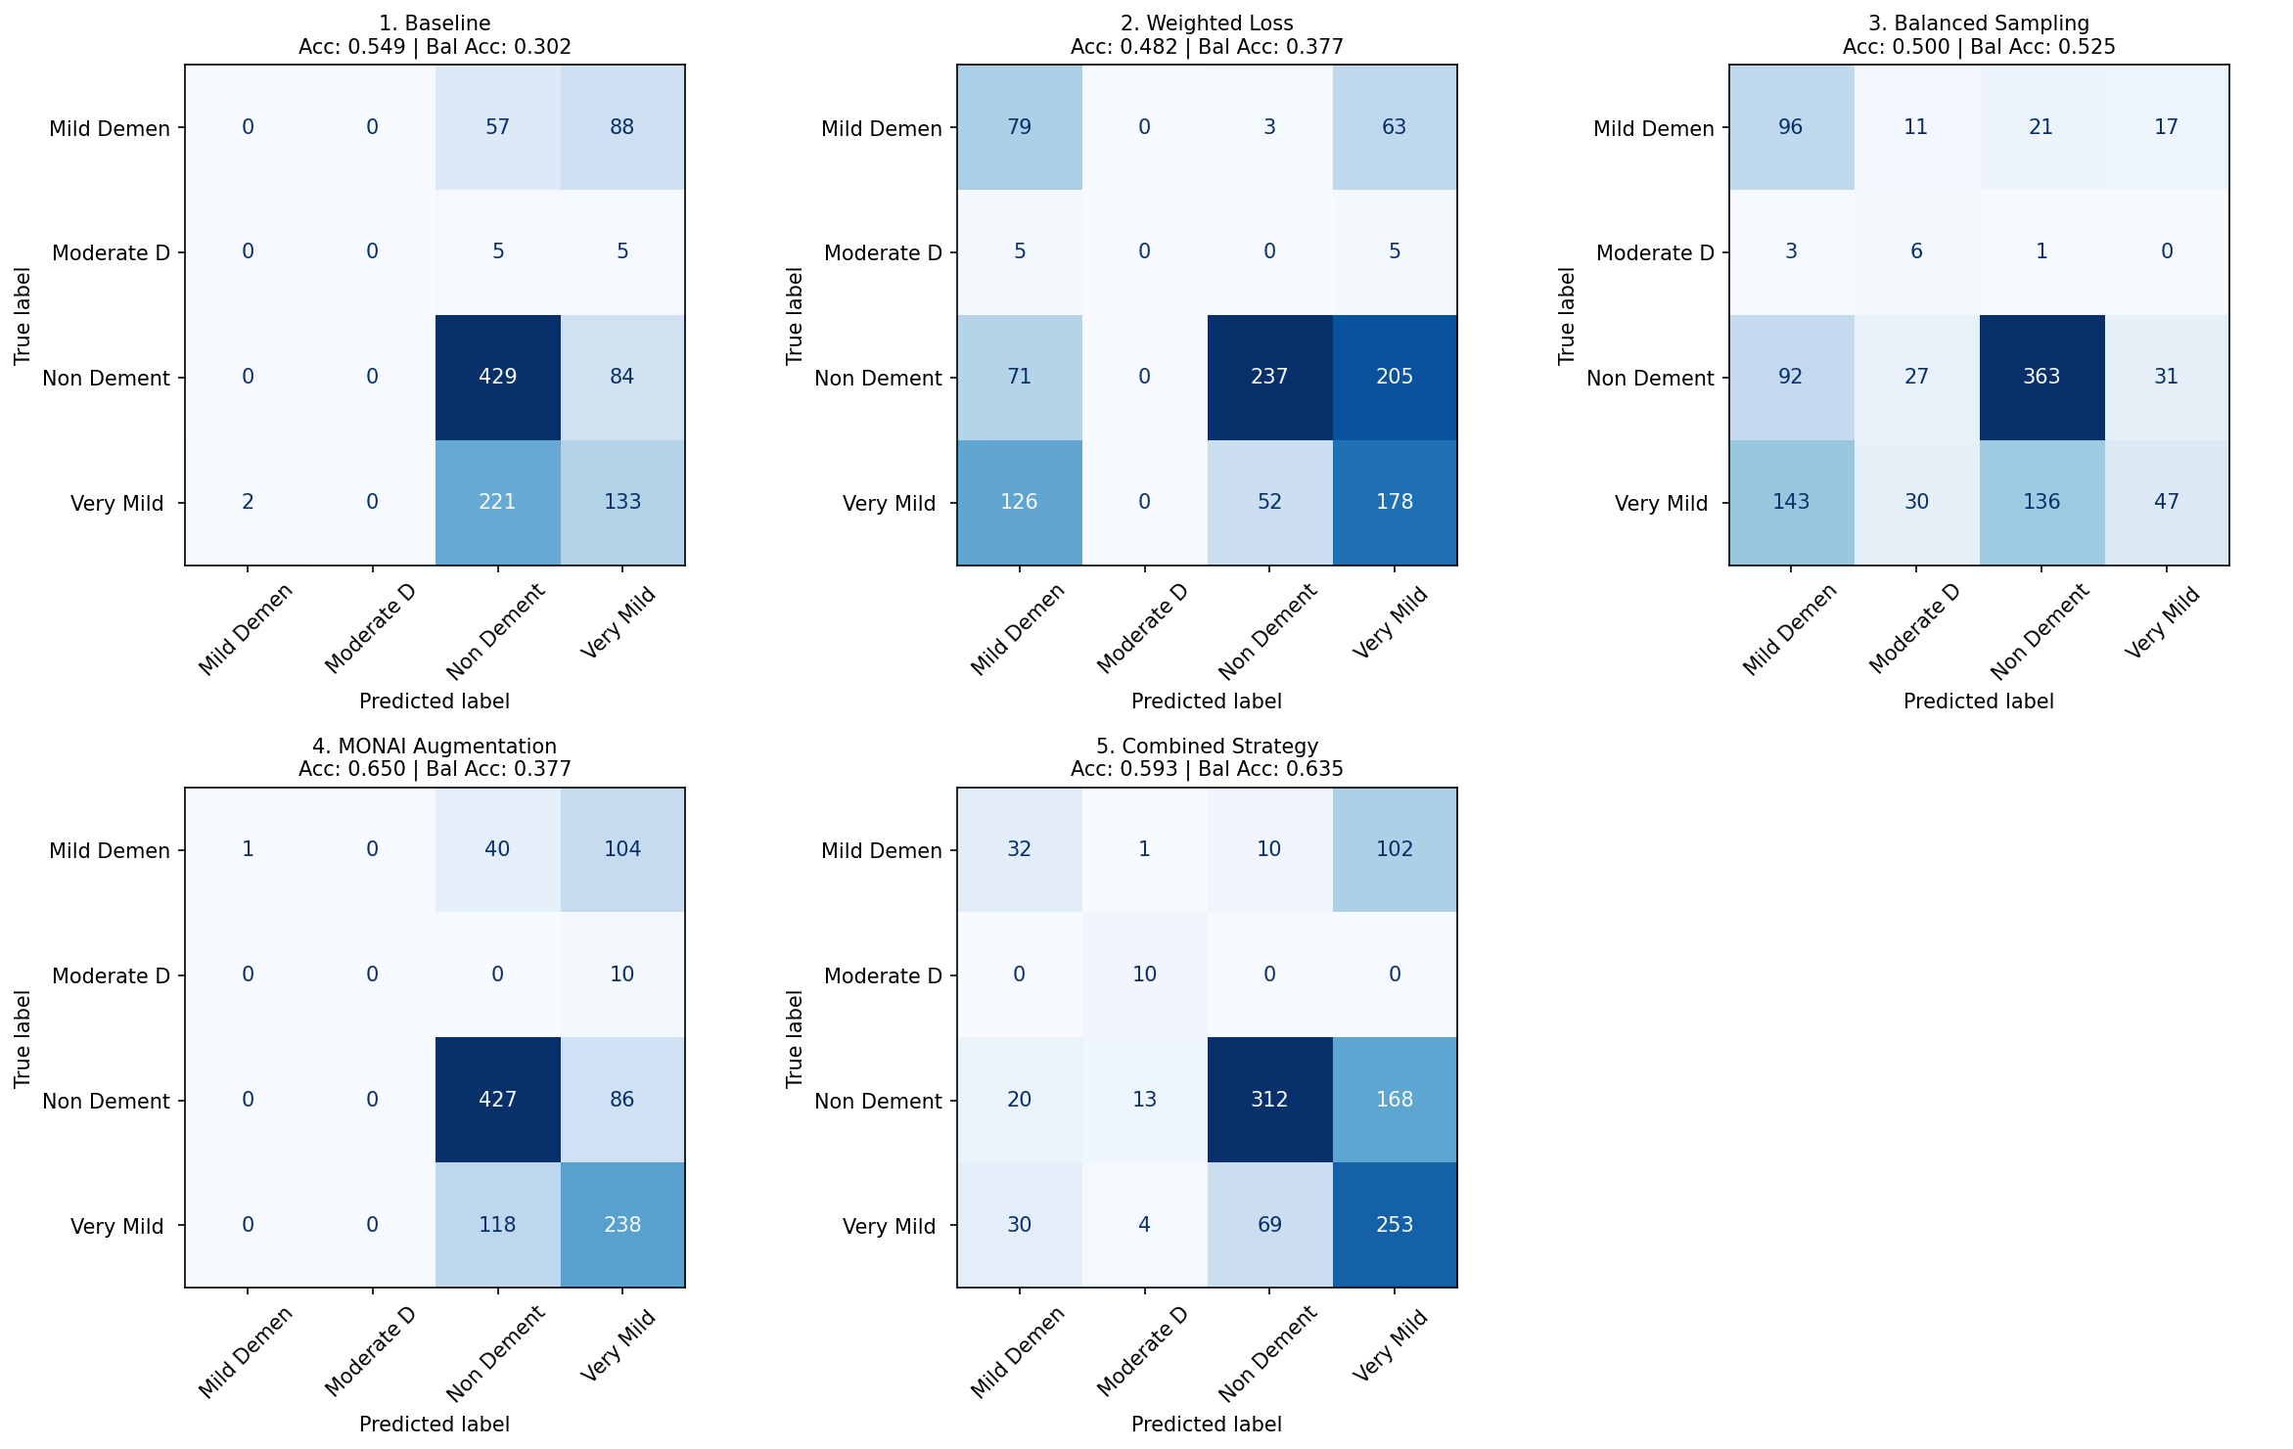
OUR EXPERIMENTS
CNN: 5 Approaches to Class Imbalance
Combined Strategy wins:
Class weights + balanced sampling + MONAI augmentation
63.5% balanced accuracy | 100% Moderate recall | F1: 0.52
Dataset: 11,519 MRI scans (Falah/Alzheimer_MRI)
4 classes: Non Dem. (3200) | Very Mild (3008) | Mild (2739) | Moderate (2572)
Baseline CNN: 0% recall on Mild & Moderate classes
Standard training fails for imbalanced medical data.
Author's experimental results, alzTheBatch repository | HuggingFace: Falah/Alzheimer_MRI | MONAI Framework

Slide 17
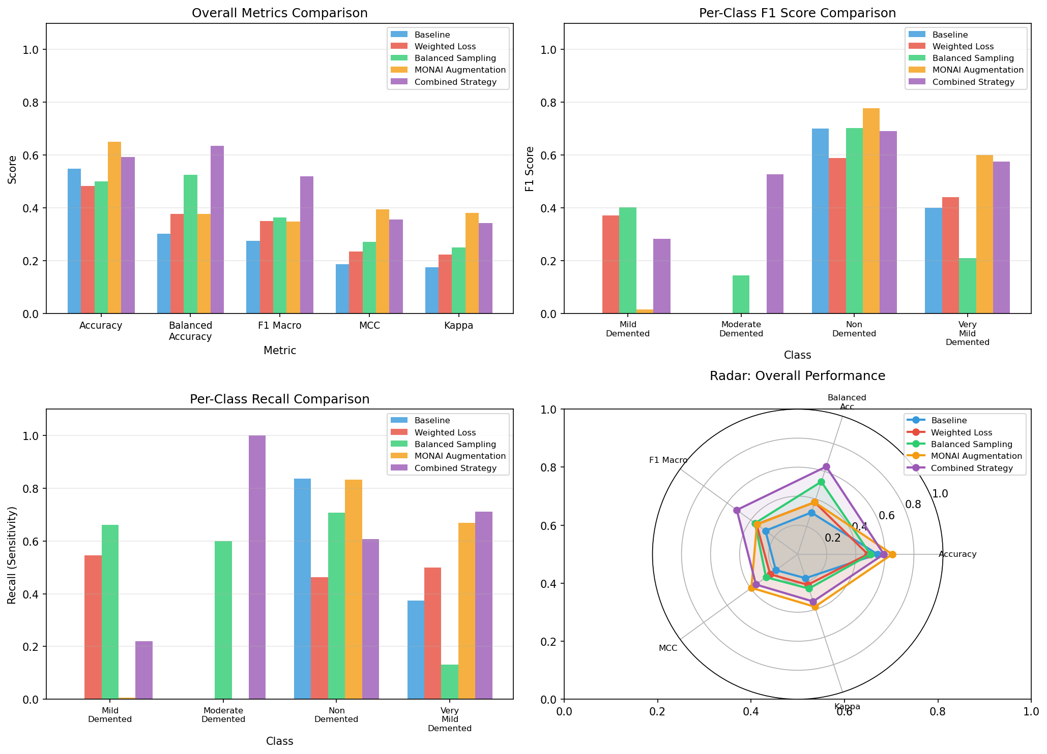
SWIN TRANSFORMER RESULTS
87.6%
Overall Accuracy (Swin-Base, ImageNet pretrained)
90.4%
89.2%
0.800
0.977
Balanced Accuracy
F1 Macro
MCC
AUC-ROC
Per-Class F1 Scores:
Mild: 0.867
Moderate: 0.952
Non-Demented: 0.896
Very Mild: 0.851
100% recall on Moderate Demented (rarest class, n=12 in test set)
Author's experimental results, alzTheBatch repository | microsoft/swin-base-patch4-window7-224 | +29pp over best CNN

Slide 18
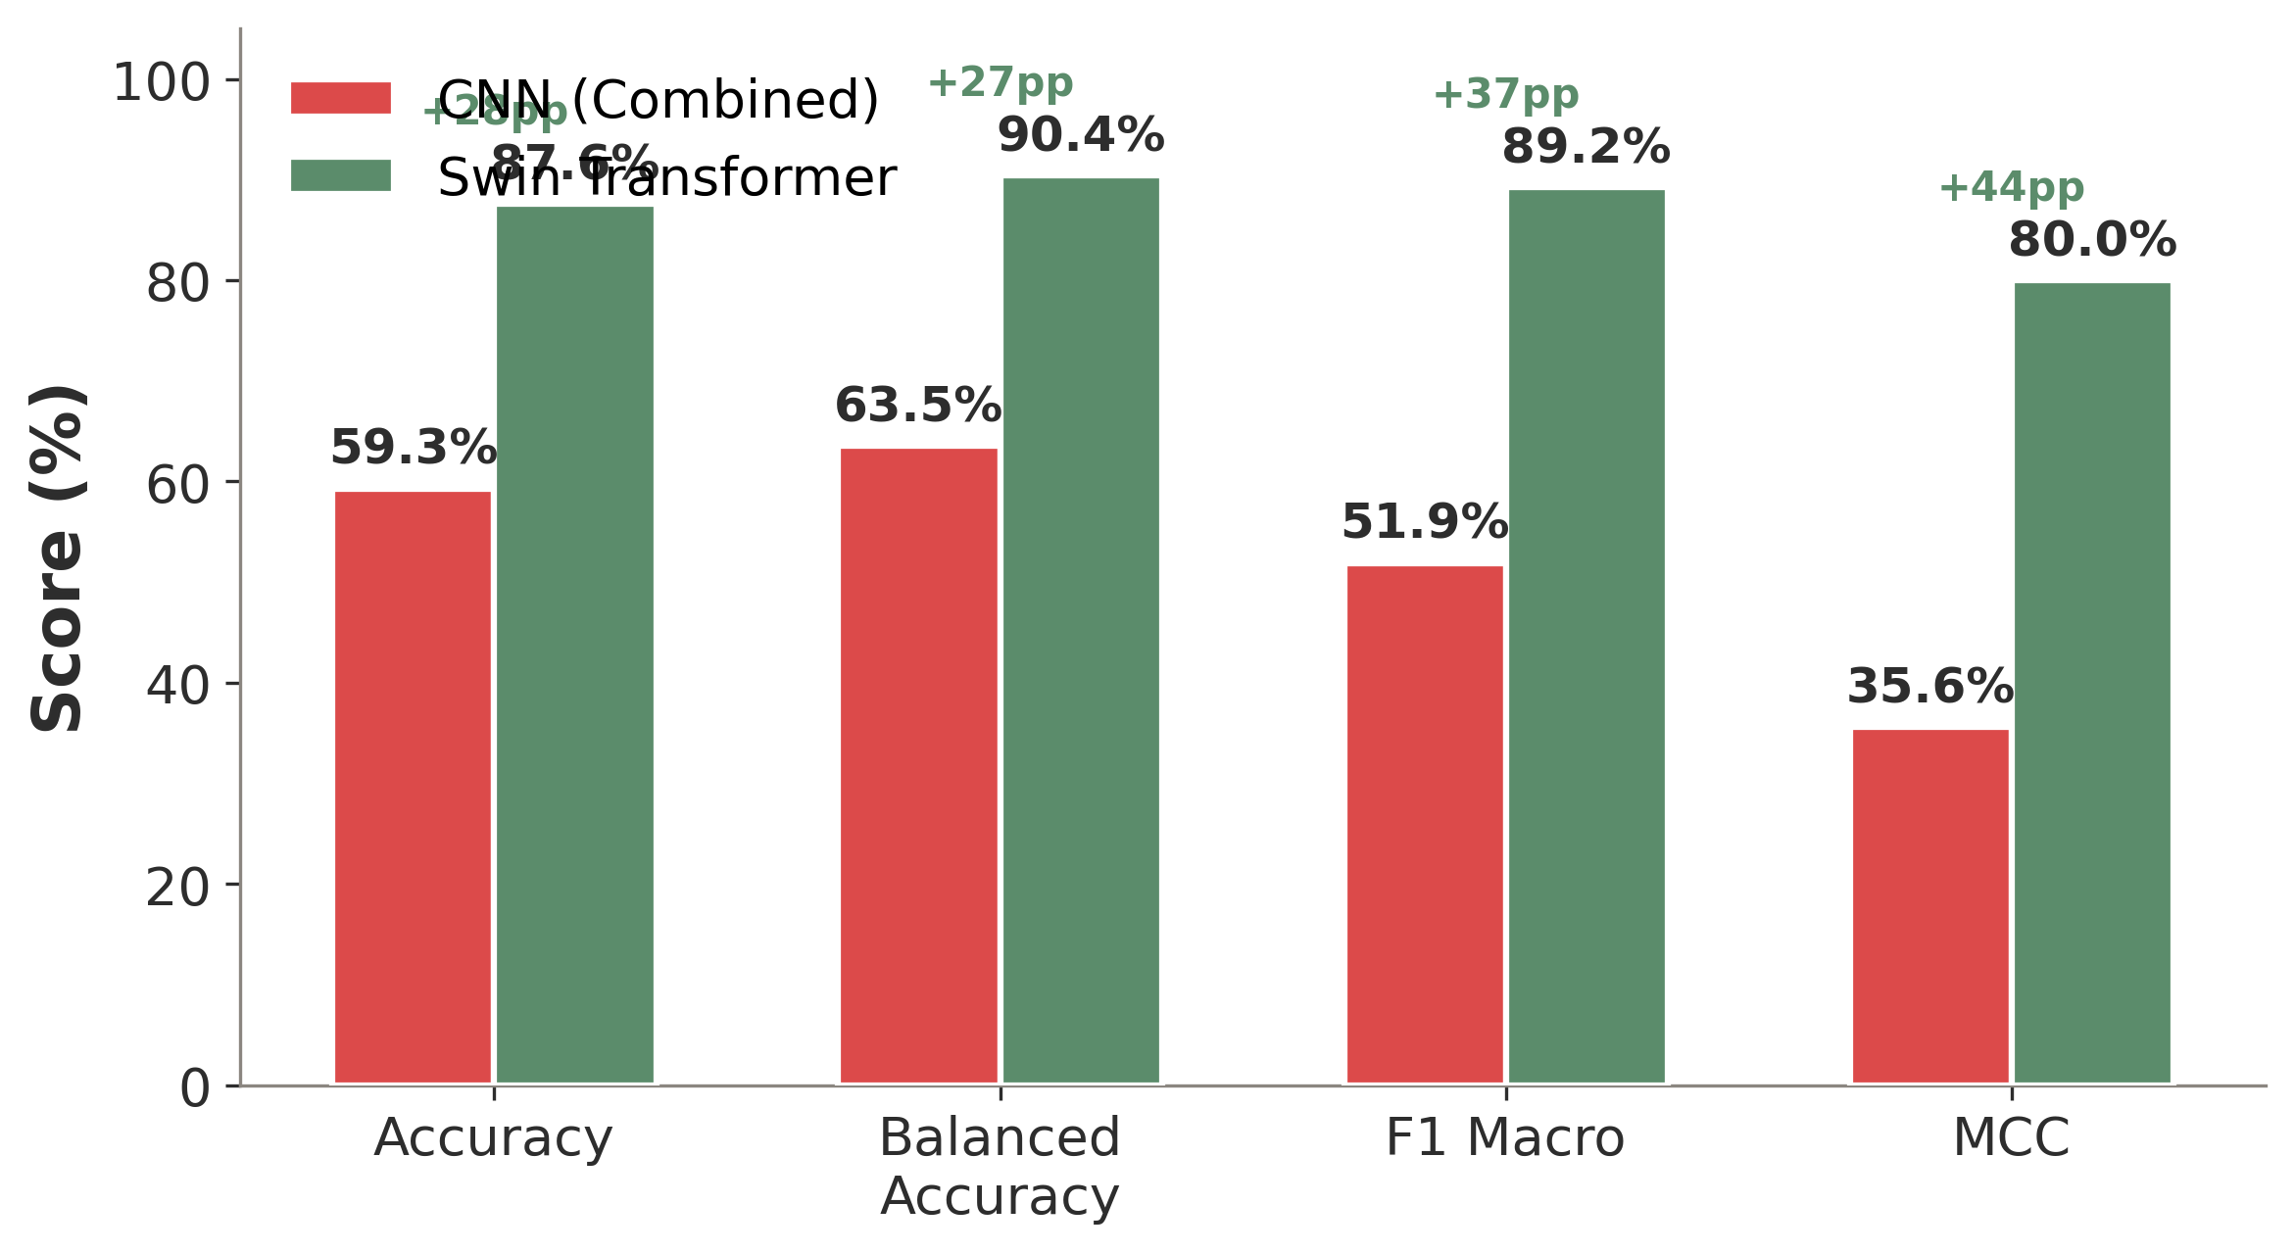
HEAD-TO-HEAD COMPARISON
CNN vs Swin Transformer: The Evidence
CNN (Combined Strategy)
Swin Transformer
Key Factors
59.3%
→
87.6%
• Transfer learning from ImageNet provides rich visual features
+29pp
• Shifted-window attention captures local + global patterns efficiently
Accuracy
Accuracy
• Differential learning rates preserve pretrained features
• Aggressive minority augmentation addresses class imbalance
• Validates thesis claims from Chapters 5–6
Author's experimental results | Liu et al., 2021 (Swin) | Deng et al., 2009 (ImageNet)

Slide 19
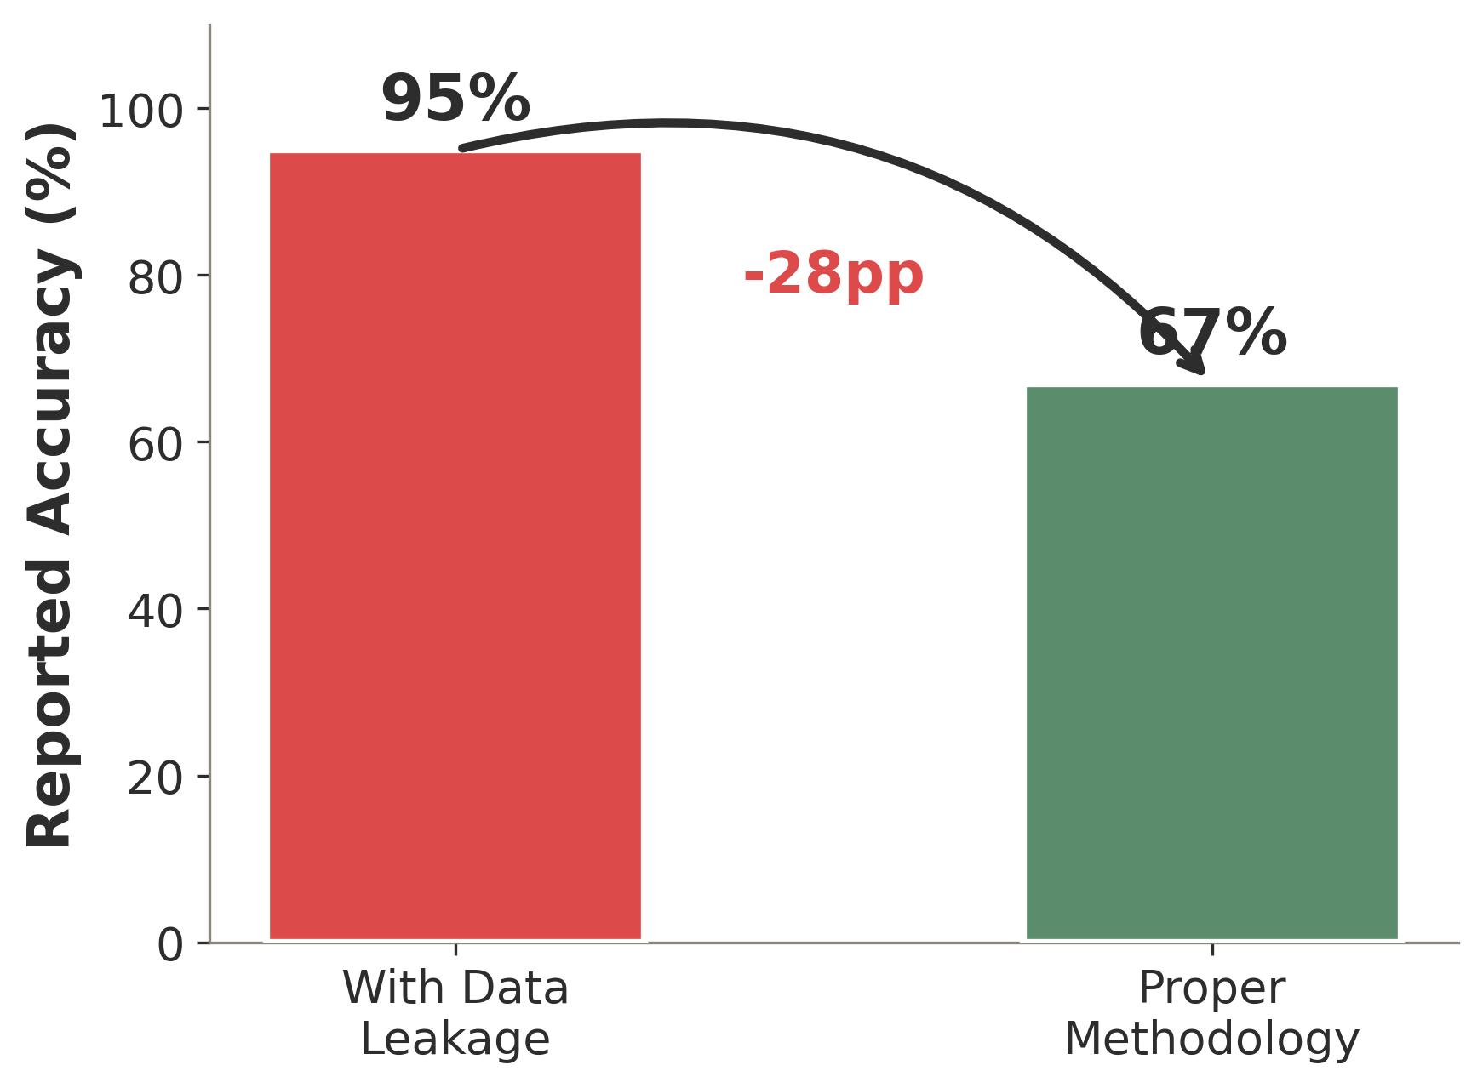
THE RECKONING
Why Models Fail in Practice
Data Leakage
Domain Shift & Shortcuts
Domain Shift:
• Models trained on ADNI drop to 71% on external data
• Scanner differences, protocol variations, population demographics
Shortcut Learning:
• Models exploit skull artifacts, not brain pathology
• Background intensity patterns correlate with scanner/site
• Grad-CAM reveals attention on non-brain regions
Both problems share a root cause:
Models learn spurious correlations rather than true disease biomarkers.
• −28% accuracy when leakage is eliminated
• Only 4.5% of studies use proper methodology
• Same-subject slices in train AND test = fatal flaw
Wen et al., 2020 | Yagis et al., 2021 | Geirhos et al., 2020

Slide 20
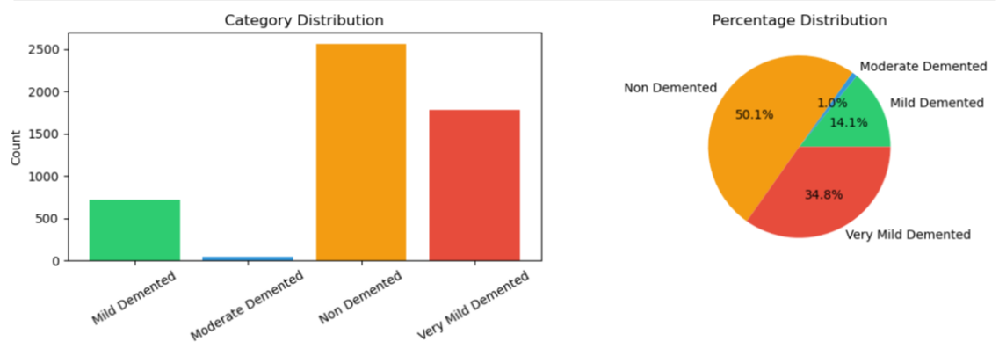
THE ACCURACY PARADOX
When 95% Accuracy is Meaningless
• Moderate Demented: only 1% of typical test sets
• A model predicting only 'Non-Demented' achieves >50% accuracy
• Balanced Accuracy, F1 Macro, and MCC are essential metrics
• Our CNN baseline: 55% accuracy but 0% recall on two classes
• Medical AI must be evaluated on the hardest cases, not the easiest
Brodersen et al., 2010 | Chicco & Jurman, 2020 | Luque et al., 2019

Slide 21
LABEL UNCERTAINTY
71%
of AD patients have mixed pathology at autopsy
• Clinical labels used for training are probabilistic, not definitive
• Gold standard diagnosis requires post-mortem examination
• Co-pathology (TDP-43, Lewy bodies, vascular) creates noisy labels
• Irreducible error floor: even perfect models cannot exceed label accuracy
• Label noise affects both training signal and evaluation metrics
Kapasi et al., 2017 | Beach et al., 2012 | Schneider et al., 2007

Slide 22
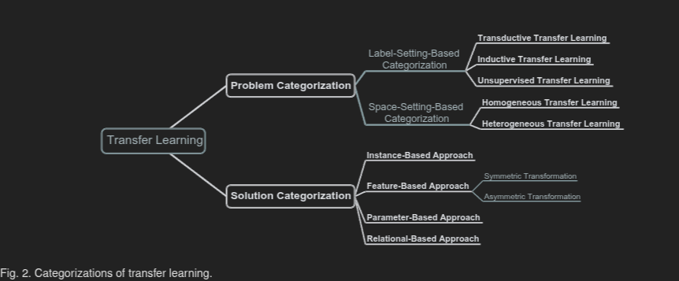
ADVANCES & THE ROAD AHEAD
Recent Progress & Future Directions
Recent Advances
Three Future Pillars
• Multimodal fusion (MRI + PET + genetics + CSF)
Standardized Benchmarks
• Self-supervised pretraining for medical images
Unified evaluation protocols eliminating data leakage
• Foundation models adapted to neuroimaging
• Transfer learning: ImageNet → medical tasks
Clinical Interpretability
• Federated learning for multi-site data
Explanations that clinicians trust and understand
Multi-Stage Diagnosis
From binary AD/HC to the full continuum of decline
Zhang et al., 2022 | Qui et al., 2022 | Tanveer et al., 2024

Slide 23
CONCLUSION
The Methodological Triad
01
02
03
Rigorous Data Handling
Balanced Evaluation
Clinical Interpretability
Subject-level splits, no data leakage, cross-site validation. Without this, reported accuracy is meaningless.
Balanced accuracy, F1 macro, MCC — not just accuracy. Our experiments confirm: baseline CNN = 55% accuracy, 0% minority recall.
Grad-CAM, SHAP, clinical validation. Models must explain why, not just what.
"Models are powerful. Data is insufficient. Trust is unearned."
Wen et al., 2020 | Author's analysis & experimental validation

Slide 24
Thank You
Questions & Discussion
Paris Karageorgakis
University of Piraeus, Department of Informatics
Thesis: github.com/paris26/Thesis_Finale
Experiments: github.com/paris26/alzTheBatch

